Slide 1
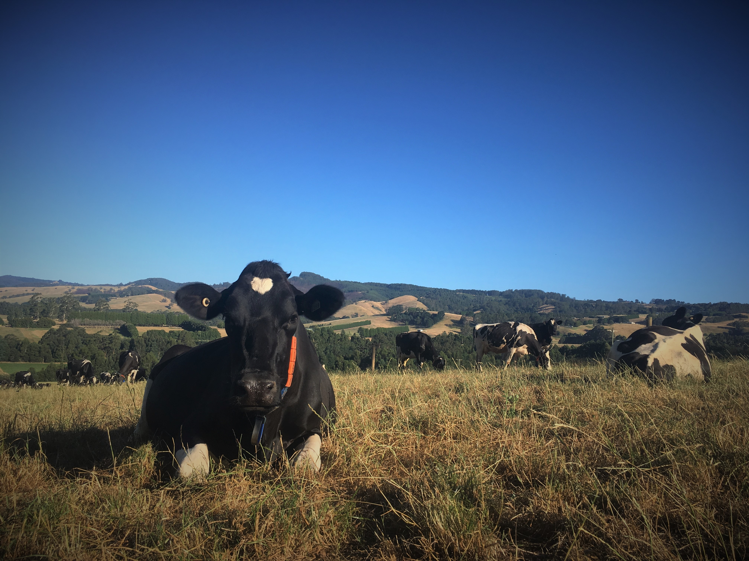
Murray Hannah, Khageswor Giri, Rodrigo Albornoz 2 Dec, 2022
Sensitivity – a flexible criterion for comparison of measurement methods:
Is the gold standard actually made of gold?

Slide 2
Proliferation of measurement technologies
Convenience
Greater coverage
Spatial
Temporal
Evaluation of a new measurement method
Is it measuring the right thing?
Is it reliable?
What is generally done?
Compare with the “Gold Standard”

Slide 3
Standard approaches to measurement method comparison
Statistic | Aspect of comparison
Correlation | Linear relationship
Regression | (Linear) relationship, Agreement, Calibration
Structural Regression | (Linear) relationship, Agreement, Repeatability, Calibration
Lin’s CCC | Agreement: Correlation, Bias (location & scale)
Var(Y₁-Y₂) decomposition | Agreement: errors of centrality, regression, disturbance
Bland-Altman, Diff vs Mean | Agreement
Mainly aimed at assessing agreement or relationship
Bland-Altman: The real question is … agreement with a gold standard
Repeatability (measurement error) also acknowledged
Unstructured sampling
Structured & structured differently?

Slide 4
What if the “Gold Standard” ain’t so gold?
Would agreement be desirable?
Might a new method be superior?
How could you tell?
By what criteria?

Slide 5
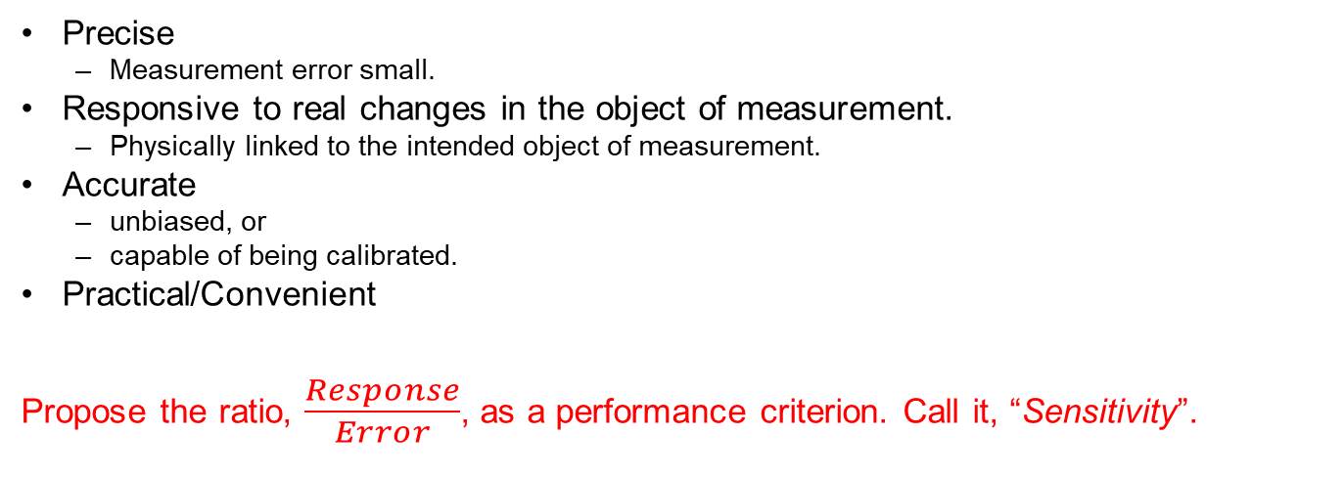
Characteristics required of a measurement method:
Precise
Measurement error small.
Responsive to real changes in the object of measurement.
Physically linked to the intended object of measurement.
Accurate
unbiased, or
capable of being calibrated.
Practical/Convenient
Propose the ratio, $\frac{Response}{Error}$, as a performance criterion. Call it, “Sensitivity”.

Slide 6
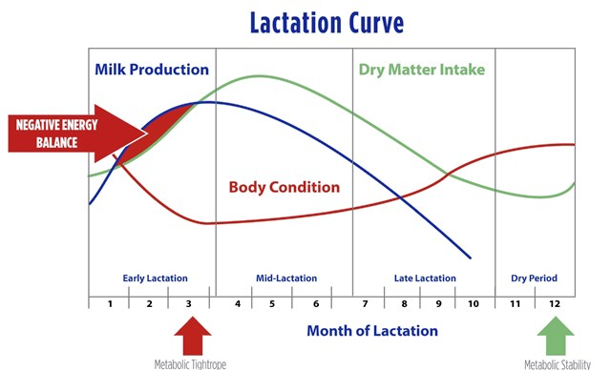
An example: Dairy Cow Body Condition Score
Body condition reflects energy reserves (fat and muscle)
A measurement is needed for commercial dairy herd management
Routinely published in the dairy literature.
BODY CONDITION
Indicator or predictor of:
Production
Reproduction
Health
Animal Welfare

Slide 7
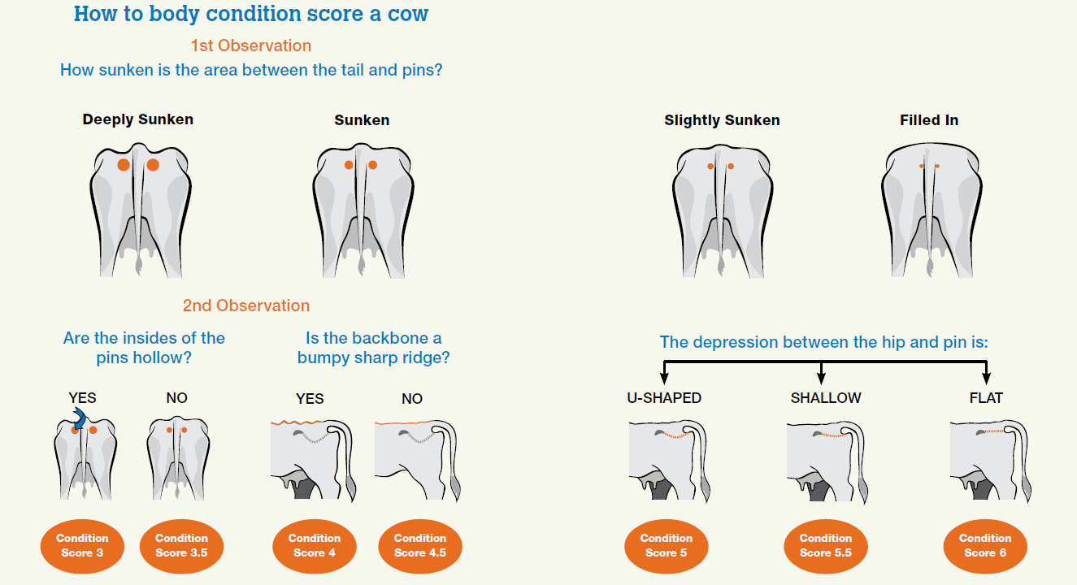
BCS
Visual score
Subjective
Ordinal
“interval”

Slide 8
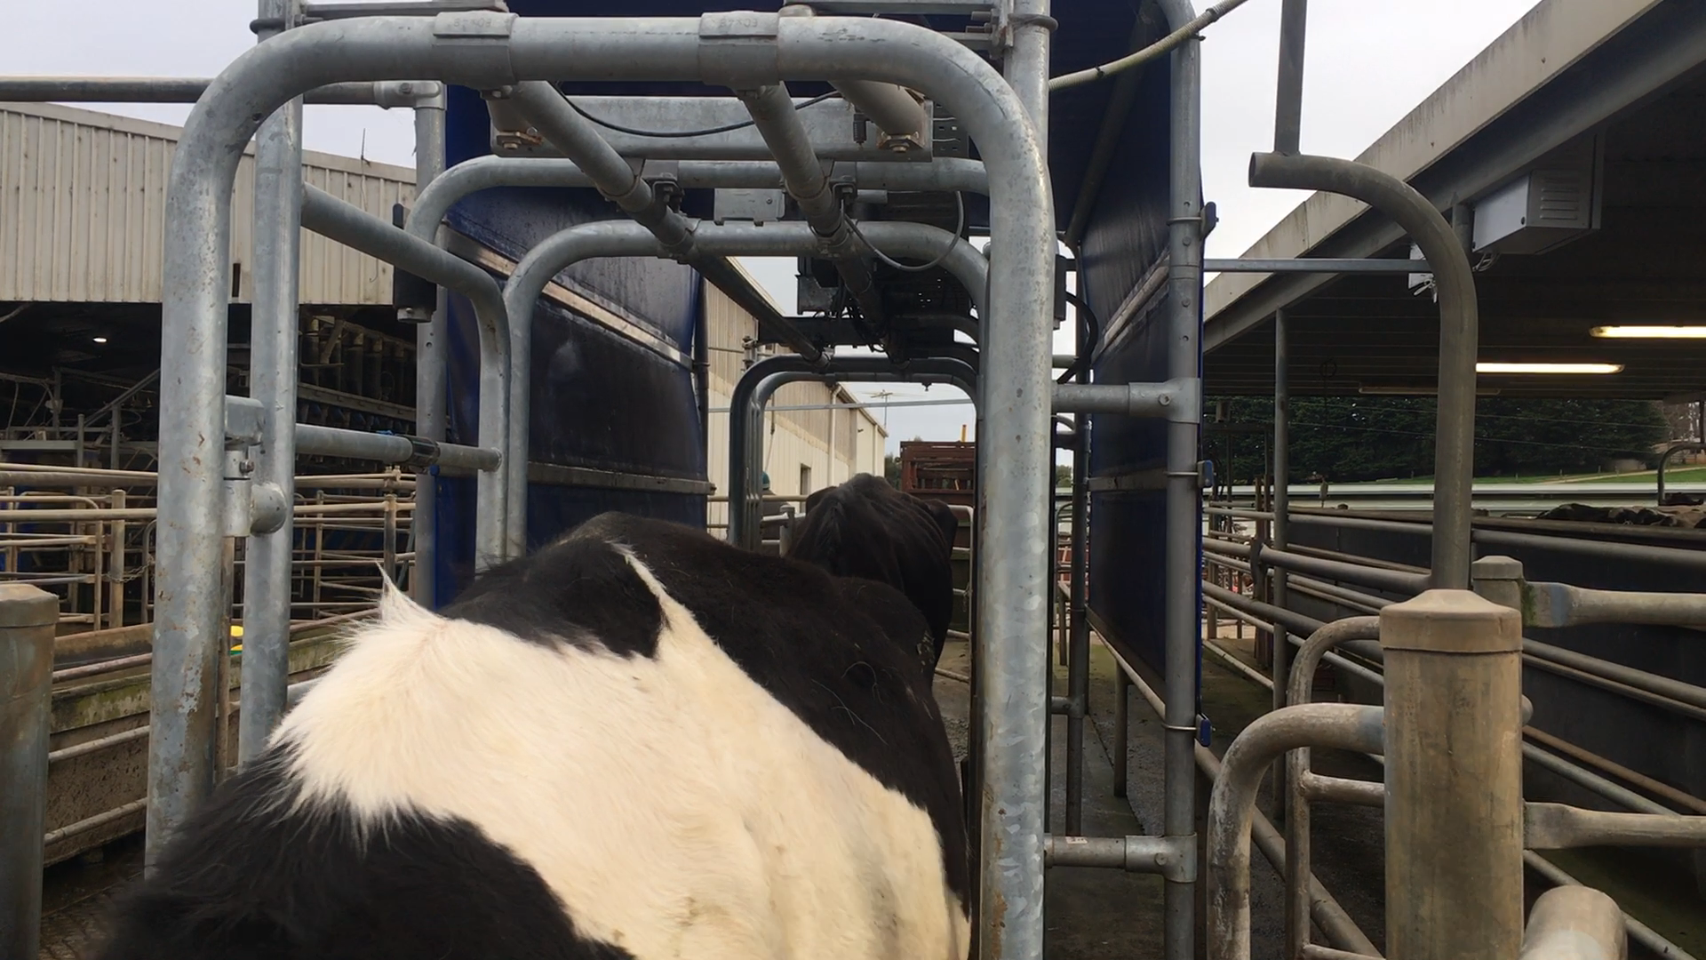
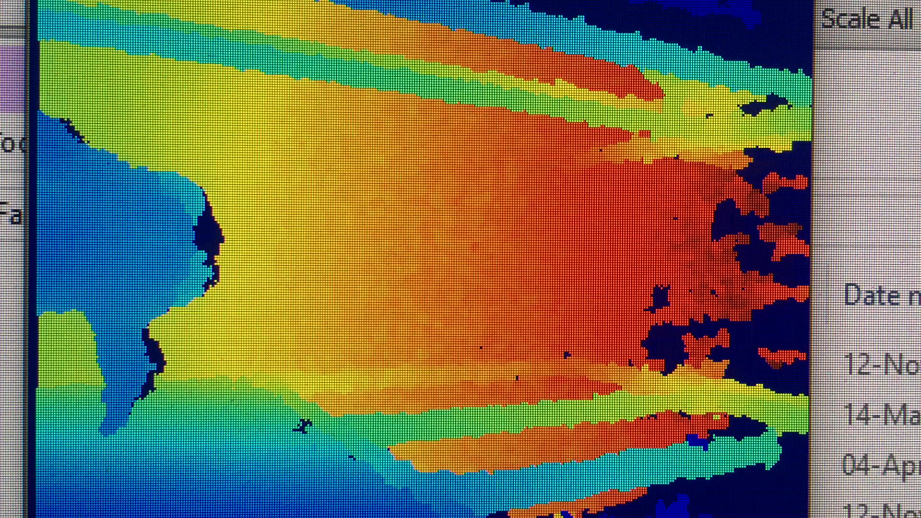
Body Condition measurement methods
Visual score
Camera + algorithm
Automate BCS
Wish to “validate”
Might it be better?
The “gold standard”

Slide 9
An Experiment
“To validate the camera for detecting changes in body condition with time”.
32 Cows
Milked twice daily
7 weeks
Method 1: Visual BCS (scale 1 – 8, in steps of 0.25)
3 trained BC scorers. Each cow scored by each scorer.
Independently
Weekly
Method 2: Camera System
2 cameras
1 on each exit from the dairy
~1 camera score per cow at each miking (2 per day)

Slide 10
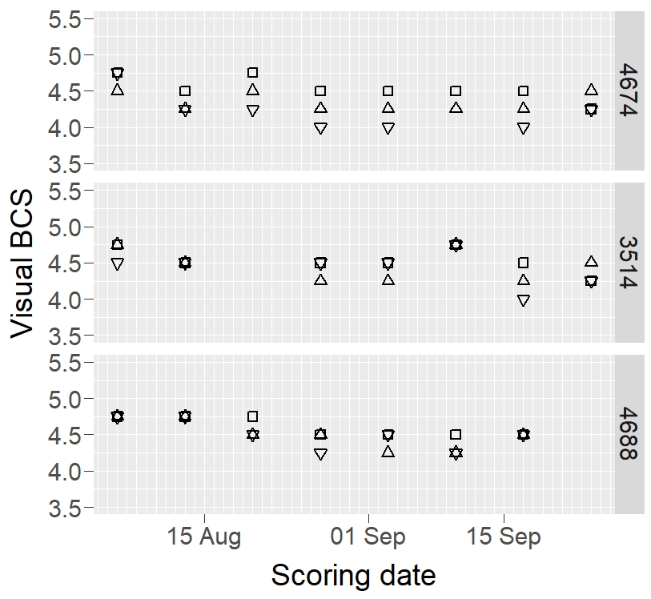
Visual BCS of 3 cows
Cows (panels), by three scorers (open squares, open triangles and inverted open triangles)

Slide 11
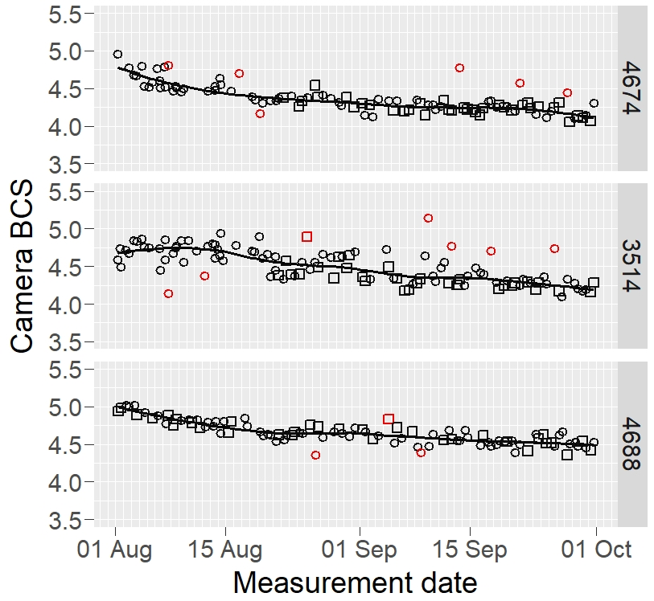
Camera BCS of same 3 cows
Cows (panels) by two cameras (open squares and circles)

Slide 12

Sensitivity:
Calculate sensitivities at a common sampling scale:
i.e. for the cow by week mean.
Descriptive models:
Visual BCS
Camera
$Sensitivity= \frac{Response}{Error}.$
Build response and error from variance components

Slide 13
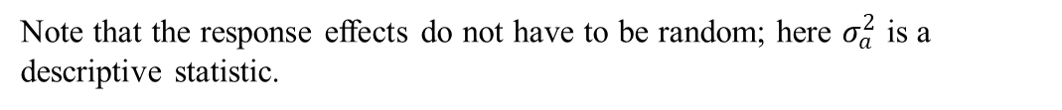
Response
The response:
$σ_{i}^{2}$, variance components that summarizing actual biological or physical effects that are the object of detection
For both the visual BCS and the camera system :
Note that the response effects do not have to be random; here $σ_{a}^{2}$ is a descriptive statistic.

Slide 14
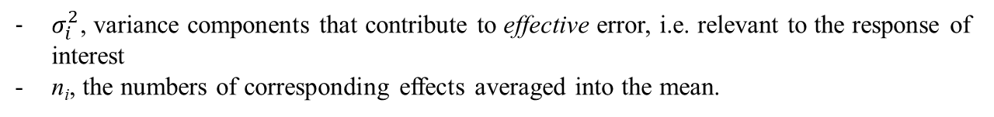
Error variance:
The effective error variance for the mean at the common scale of comparison,
$σ_{i}^{2}$, variance components that contribute to effective error, i.e. relevant to the response of interest
n_{i}, the numbers of corresponding effects averaged into the mean.
For the visual BCS:
For the camera system:

Slide 15
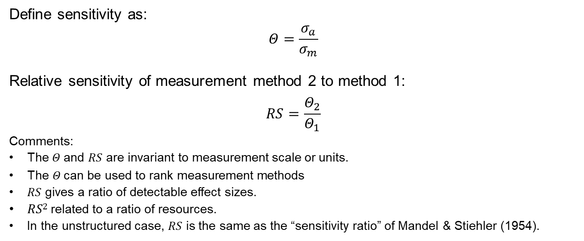
Sensitivity:
Define sensitivity as:
$$Θ=\frac{σ_{a}}{σ_{m}}$$
Relative sensitivity of measurement method 2 to method 1:
$$RS=\frac{Θ_{2}}{Θ_{1}}$$
Comments:
The $Θ$and $RS$ are invariant to measurement scale or units.
$\text{The} Θ \text{can} \text{be} \text{used} \text{to} \text{rank} \text{measurement} \text{methods}$
$RS$ gives a ratio of detectable effect sizes.
$RS2$related to a ratio of resources.
In the unstructured case, $RS$ is the same as the “sensitivity ratio” of Mandel & Stiehler (1954).

Slide 16
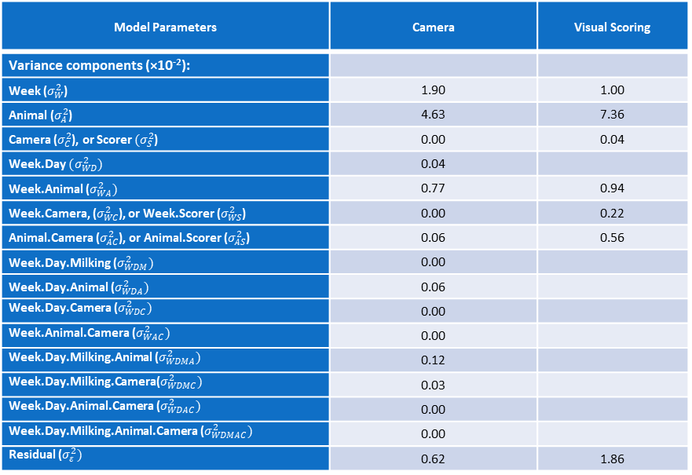
Model Parameters | Camera | Visual Scoring
Variance components (×10⁻²):
Week ($σ_{W}^{2}$) | 1.90 | 1.00
Animal ($σ_{A}^{2}$) | 4.63 | 7.36
Camera ($σ_{C}^{2}$), or Scorer $(σ_{S}^{2}$) | 0.00 | 0.04
Week.Day $(σ_{WD}^{2})$ | 0.04
Week.Animal ($σ_{WA}^{2})$ | 0.77 | 0.94
Week.Camera, ($σ_{WC}^{2}$), or Week.Scorer ($σ_{WS}^{2}$) | 0.00 | 0.22
Animal.Camera ($σ_{AC}^{2}$), or Animal.Scorer ($σ_{AS}^{2}$) | 0.06 | 0.56
Week.Day.Milking ($σ_{WDM}^{2})$ | 0.00
Week.Day.Animal ($σ_{WDA}^{2})$ | 0.06
Week.Day.Camera ($σ_{WDC}^{2})$ | 0.00
Week.Animal.Camera ($σ_{WAC}^{2})$ | 0.00
Week.Day.Milking.Animal ($σ_{WDMA}^{2})$ | 0.12
Week.Day.Milking.Camera($σ_{WDMC}^{2})$ | 0.03
Week.Day.Animal.Camera ($σ_{WDAC}^{2})$ | 0.00
Week.Day.Milking.Animal.Camera ($σ_{WDMAC}^{2})$ | 0.00
Residual ($σ_{ε}^{2})$ | 0.62 | 1.86

Slide 17
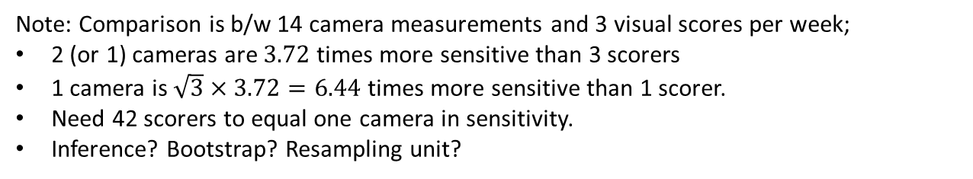
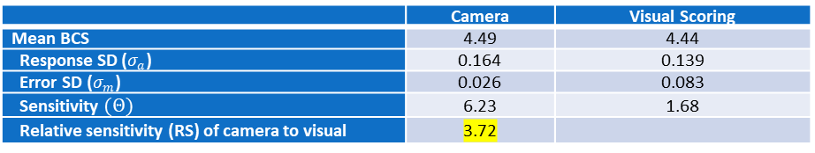
Sensitivity for change over weeks within an animal:
 | Camera | Visual Scoring
Mean BCS | 4.49 | 4.44
Response SD ($σ_{a}$) | 0.164 | 0.139
Error SD ($σ_{m}$) | 0.026 | 0.083
Sensitivity $(Θ)$ | 6.23 | 1.68
Relative sensitivity (RS) of camera to visual | 3.72
Note: Comparison is b/w 14 camera measurements and 3 visual scores per week;
2 (or 1) cameras are $3.72$ times more sensitive than 3 scorers
1 camera is $\sqrt{3}×3.72=6.44$ times more sensitive than 1 scorer.
Need 42 scorers to equal one camera in sensitivity.
Inference? Bootstrap? Resampling unit?

